Slide 1
Data Engineering
Enterprise Data Management - Infrastructures

Slide 2

Module Objectives
After completing this course you will be able to:
Explain the concept of big data
Describe all the components of a data warehousing architecture
Understand when and why a distributed approach is needed
Explain how to make effective use of data lakes
Understand how on-premise and cloud-based systems are integrated

Slide 3
A Little History
With the rise of the internet, high volumes of data became available
Companies saw this as an opportunity
The increased load challenged traditional Enterprise Data Management (EDM) solutions
This triggered a race for innovation
The term “big data” quickly became a buzzword
But just how big does data have to be, to be considered big data?
Petabytes? Exabytes? Zettabytes?
The target keeps moving!

Slide 4
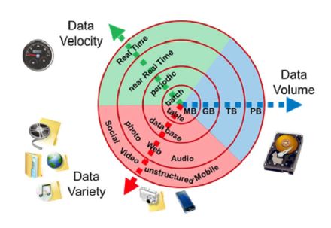
Not Just Volume
Big Data can be characterized by 5 V’s:
Volume
Variety
Velocity
Veracity
Validity
Originally, there were only 3 V’s

Slide 5
The 5 V’s
Volume
Huge data volumes need to be stored, accessed and processed in a timely manner
We’ve entered the Zettabyte Era!
Exponential growth due to the internet, IoT, streaming services, AI, …
Even the most powerful supercomputers can’t do it on their own
Variety
Big data comes in a wide range of formats:
Structured (relational database tables)
Semi-structured (CSV, logs, XML, JSON, …)
Unstructured (text files, Word docs, Pdfs, emails, binary, …)
It may also come from a wide range of sources:
internal, third party, the web, environment, …
Notes:
Data is measured in bits and bytes. One bit contains a value of 0 or 1. Eight bits make a byte. Then we have kilobytes (1,000 bytes), megabytes (1000² bytes), gigabytes (1000³ bytes), terabytes (1000⁴ bytes), petabytes (1000⁵ bytes), exabytes (1000⁶ bytes) and zettabytes (1000⁷ bytes).
Cisco estimated that in 2016 we have passed one zettabyte in total annual Internet traffic. According to many, such milestone marks the beginning of the Zettabyte Era. Internet traffic is only one part of the total data storage. In 2019, estimates for the total data storage capacity were already in the 10–50 zettabyte range. This number may have gone up substantially in 2020, with the sharp increase in remote work during the pandemic, and it shows no sign of slowing down.
While once 1 Gigabyte (GB) was considered big data, it no longer does. Currently, that threshold has moved up at least to the Terabyte (TB), if not even the Petabyte (PB) range. For a more detailed analysis:
https://towardsdatascience.com/how-big-is-big-data-3fb14d5351ba

Slide 6
The 5 V’s
Velocity
Big data tends to be continuously generated
But processing and publishing frequency may vary
Stream vs. Batch vs. Mini-batch
Veracity
One dimension related to data quality
Big data varies in truthfulness (or reliability)
Validity
Another dimension related to data quality
Big data varies in intrinsic value (or usefulness)

Slide 7
Another Definition
The 5 V’s were originally 3 V’s
More and more dimensions keep being added (variability, scalability, …)
Again, another moving target problem
Here’s a more generic definition:
Big data is data that cannot be read, stored, processed,
analysed or transmitted, using traditional techniques and tools
This gives us a more intuitive understanding
Still, the notion of “traditional techniques and tools” varies over time

Slide 8
Data Warehousing: The Traditional Architecture
Traditionally, companies have relied on a centralized architecture to store their data
Each department keeps its data in its own operational database
Data from all the operational DB’s is then integrated into the Data Warehouse (DWH)
The data in the dwh is further processed and sent to several data marts
The data warehouse is the single repository at the center of this architecture
The dwh stores historical data used to support business decisions
Data marts contain data suitable for reporting and analysis
Employees may still access raw data from their department’s operational db
ETL and ELT processes are used in the data transfers
This approach is typically followed in Business Intelligence (BI)
Notes:
ETL / ELT :
ETL stands for Extract Transform and Load, while ELT stands for Extract, Load and Transfer. They are two common approaches used to cleanse, process and integrate data, and to transfer it from one storage system to another. We will treat them in more details in future modules.
DATA WAREHOUSE / DATA MART :
From https://en.wikipedia.org/wiki/Data_mart :
“Warehouses and data marts are built because the information in the database are not organized in a way that makes it readily accessible. This organization requires queries that are too complicated, difficult to access or resource intensive.”
“While transactional databases are designed to be updated, data warehouses or marts are read only. Data warehouses are designed to access large groups of related records. Data marts improve end-user response time by allowing users to have access to the specific type of data they need to view most often by providing the data in a way that supports the collective view of a group of users.”
“A data mart is basically a condensed and more focused version of a data warehouse that reflects the regulations and process specifications of each business unit within an organization. Each data mart is dedicated to a specific business function or region. This subset of data may span across many or all of an enterprise’s functional subject areas. It is common for multiple data marts to be used in order to serve the needs of each individual business unit (different data marts can be used to obtain specific information for various enterprise departments, such as accounting, marketing, sales, etc.).”

Slide 9
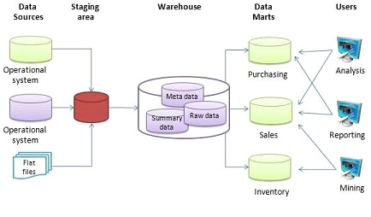
Data Warehousing: The Traditional Architecture
The basic data warehousing architecture:
Notes:
Data sources (left) contain data “at its rawest”. As it passes through the pipeline, data gets cleaned, merged, standardized and further prepared for a variety of use cases. This process enables business users to ultimately gain valuable insight from it.

Slide 10
Open Conversation
Advantages and disadvantages of a centralized architecture
Duration - 15 minutes.
Discussion & Feedback.

Slide 11
Pro’s of the DWH Architecture
Integrating data from multiple sources into a single database
Providing a single common data model, regardless of the source of the data
Enabling a central view across the enterprise
particularly valuable when the organization has grown by merger
Producing data that makes sense to the business users (through datamarts)
Presenting the organization's information consistently
by providing consistent codes and descriptions, flagging or even fixing bad data
by organizing and disambiguating repetitive data
Improve query performance, without affecting operational databases
Maintaining historical data, even if the source transaction systems do not
Notes:
Overall, this boils down to improved data quality and performance

Slide 12
Con’s of the DWH Architecture
Data warehouses remain useful to this day
But a centralized architecture fails to deal with the increasing complexities of big data:
Volume
Variety
Velocity
…
Meanwhile, a rigid separation between data marts favours data silos:
A bunch of non-communicating storage systems

Slide 13
The Data Lake Architecture
Data Lakes were introduced to overcome the limits of DWH in dealing with big data:
Data lakes are distributed repositories
where many data streams flow in from multiple sources
and can be stored and processed in a variety of formats
Each machine is known as a node
They typically consist of inexpensive commodity hardware
Nodes are grouped in clusters
Cluster sizes may vary
anywhere from two to hundreds of thousands of nodes

Slide 14
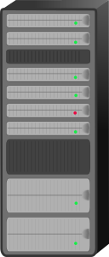



Data Lakes: The Distributed Approach
A rapidly increasing data size requires the flexibility of a distributed architecture
The most powerful supercomputer alone would struggle to keep up with demand
11000111
1100
0111
1111000111

Slide 15
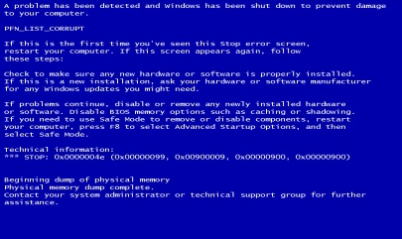
Data Lakes: The Distributed Approach
A rapidly increasing data size requires the flexibility of a distributed architecture
Eventually, all supercomputers will need to be replaced
011011001
011110001
101110000

Slide 16


Data Lakes: The Distributed Approach
A rapidly increasing data size requires the flexibility of a distributed architecture
By distributing resources, work can be accomplished more efficiently
1011010111
1111010101
0011001111

Slide 17
Data Lakes: The Distributed Approach
A rapidly increasing data size requires the flexibility of a distributed architecture
If demand goes up, just scale out by adding more cheap nodes
1011010111
1011110110
1100110000
0011001111
Notes:
Just a note on terminology, scaling up vs. scaling out:
https://www.techopedia.com/7/31151/technology-trends/what-is-the-difference-between-scale-out-versus-scale-up-architecture-applications-etc

Slide 18
Data Lakes & Data Warehouses
Does this mean that Enterprise Data Warehouses are now obsolete?

Slide 19
Data Lakes & Data Warehouses
Does this mean that Enterprise Data Warehouses are now obsolete?
Absolutely Not!

Slide 20
Data Lakes & Data Warehouses
Does this mean that Enterprise Data Warehouses are now obsolete?
Absolutely Not!
The Data Warehouse remains a core component in every company’s data infrastructure
It is still the best fit for consolidated data that is
structured and normalized
abiding by all internal and external policies
small
Locality, centralized architecture and structured data all ensure
faster and easier access
Perfect for high-intensity and mass-extraction tasks
greater security
Notes:
Data consolidation refers to the collection and integration of data from multiple sources into a single destination.
The suitability for small data is due to the fact that data lake architectures like Hadoop can’t handle small files efficiently (look up: small files problem).

Slide 21
Data Lakes: Best Practices
How can data lakes be used effectively?

Slide 22
Data Lakes: Best Practices
How can data lakes be used effectively?
Several questions need to be answered at every step of the adoption process
How many data sources are there? What kind of sources are they?
How is the data generated: batches or streams? How frequently?
How is it formatted: structured / unstructured? Or a mix?
How much work is required to prepare it?
What kind of insights are our business users looking for?
Is all the required expertise available in-house?
How is data currently managed in the existing infrastructure?
It’s easy to lose focus and management’s attention!
Notes:
Sources could be on-premise, including dwh’s, operational db’s, flat files, etc... Or, they could be cloud-based, environmental (e.g. generated by sensors), obtained from wireless networks (e.g. IoT data), the world wide web (e.g. social media data), etc…

Slide 23
Data Lakes: Best Practices
How can data lakes be used effectively?
2. An Agile approach to data management goes a long way
Break down final goal into a series of quick wins (increments)
Order business goals by priority/effort ratio
Consult with all stakeholders throughout the process
this keeps the need to revisit architectural model and data protocols low
it helps to keep both IT and business leaders engaged
it makes it easier to seize new business opportunities
Try out many data management tools and strategies
Test, compare and refine them, empirically

Slide 24
Data Lakes: Best Practices
How can data lakes be used effectively?
3. Always be careful not to create data swamps
a data lake that grows without vision nor governance
due to store-now-find-value-later approach (very common mistake)
the assumption is that you can’t get value from data that isn’t at hand
but data that is at hand doesn’t automatically generate value
also, data reduction doesn’t necessarily translate to loss of value:
it helps to prevent messy data and cluttered storage
which enhances the ability to extract more value
by dedicating more time and resources to that aim
it also allows to make decisions in a timely manner
Notes:
Data swamp refers to a data lake that grows without vision nor governance. This is one of the most common mistakes organizations make. They tend to use the data lake as a storage system for each and every piece of information that is ever generated, thinking that any type of filter could result in a loss of potentially valuable insights.
Such an approach would perhaps be suitable if information was scarce. In reality, we tend to have the opposite problem: a flood of information coming from all corners! Business and IT leaders are overwhelmed by the sheer volume and variety of data at their disposal, the speed at which information is traversing internal and external networks, and the cost of managing all this business intelligence.
This situation leads to time and resources being taken away from the main goal, which is to harness meaningful insights from all this business information. It also produces messy, useless and/or redundant data that keeps hanging around and will need to be managed eventually.
Here’s an example of a data reduction technique (from https://www.forbes.com/sites/danwoods/2016/08/26/why-data-lakes-are-evil/?sh=279d27314f73):
“[…] consider a temperature sensor on a turbine. If the temperature reaches a certain threshold, action should be taken to shut it down or dispatch someone to fix it. That’s timely information. And even for the long term, if the sensor transmits the temperature every 15 seconds, you don’t need to store all those values along with timestamps; you can summarize the data when the temperature is stable without actually losing any information.”

Slide 25
Data Lakes: Use Cases
How do data lakes fit into the existing data architecture?

Slide 26
Data Lakes: Use Cases
How do data lakes fit into the existing data architecture?
1. As staging areas for the data warehouse
pure-capture environment for data flowing in from a varying array of sources
requires less data governance than dwh
provides more storage
after further preparation and selection, data can be consolidated into dwh
Again, watch out for data swamps!
carefully choose data governance rules
consider possible data reduction techniques as well
apply an Agile approach
Notes:
In reality, data lakes can function as raw data reservoirs, which are more than simple staging areas. A staging area has a single downstream consumer: the data warehouse. The raw data reservoir can also be used to populate the dwh, but it can serve other consumers as well, such as:
Sandboxes for self-service and advanced analytics
Enterprise search engines
Mobile Device Management hub (MDM hub)
and more
One of the benefits of making the raw data available to more consumers is that we don’t hit our source systems multiple times. This is possible because data lakes are able to store data in its original form. Moreover, we can optionally audit and version the raw data, in order to keep an immutable history of changes, which might be useful for compliance reasons.

Slide 27
Data Lakes: Use Cases
How do data lakes fit into the existing data architecture?
2. As offloads for the data warehouse
enterprise data warehouses can send data back to the data lake
large, more detailed datasets
old data and data that is rarely accessed
summary and frequently accessed data stays in the dwh
High-intensity, mass-extraction tasks can take place there
data lake’s cheap and scalable storage can handle larger volumes
low-intensity tasks can take place there
For example, “needle-in-a-haystack” type of searches
Notes:
A needle in a haystack search refers to a low-intensity extraction and transformation task, in which data scientists need to sweep databases for queries not supported by traditional index structures.

Slide 28
Data Lakes: Use Cases
How do data lakes fit into the existing data architecture?
3. As sandbox environments for predictive analytics
think of a “temporary data mart”
quick and easy to spin up
cheaper to scale out
more adaptable to changes
data is kept raw and transformed only when needed, as needed
perfect testbed for a wide range of experiments, including:
bringing new data sources into existing data architecture
building prototypes for new analytics projects
Notes:
Some concrete examples of possible scenarios for this use case include:
Data profiling and exploratory analysis when a new subject area is added to the data warehouse
Performance analysis for a newly acquired company
Advanced predictive analytics projects (predicting churn, revenue, bankruptcy, etc…)

Slide 29
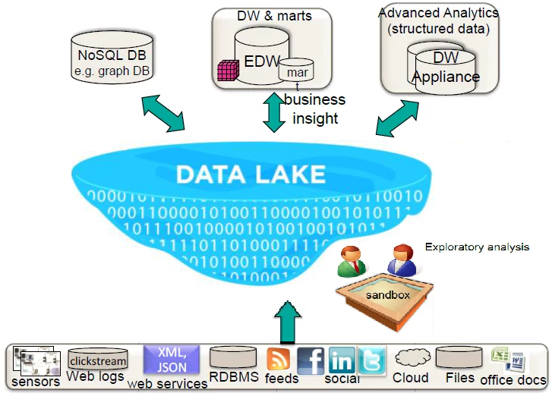
The Data Lake Architecture: Summary
Notes:
References:
https://en.wikipedia.org/wiki/Data_lake
Opportunities offered by data lakes (including self-service analytics):
https://www.mckinsey.com/business-functions/mckinsey-digital/our-insights/a-smarter-way-to-jump-into-data-lakes
https://www.analyticsinsight.net/self-service-analytics-advantages-challenges/#:~:text=%20Self-Service%20Analytics:%20Advantages%20&%20Challenges%20%201,the%20analysis%20procedure.%20With%20the%20humongous...%20More
Critiques of data lakes (specifically, of their uses as “store-everything repositories”, as well as systems for self-service analytics):
https://sonra.io/2017/08/08/are-data-lakes-fake-news/
https://www.forbes.com/sites/danwoods/2016/08/26/why-data-lakes-are-evil/?sh=279d27314f73
List of white papers from Bill Inmon’s page (very insightful):
http://www.forestrimtech.com/white-papers/

Slide 30
Open Conversation
We have seen the pro’s of data lakes. Can you think of some con’s?
Duration - 15 minutes.
Discussion & Feedback.

Slide 31
Con’s of the Data Lake Architecture
Complexity
Distributed architecture is inherently more complex than centralized one
Start-up cost
large amount of hardware required
Maintenance cost
while upscaling is cheaper, maintaining is not
Security
Required expertise
Set-up time

Slide 32
Data Lakes in the Cloud
Cloud providers now offer data-lake-as-a-service, solving many issues on-premise data lakes face
No need to deal with complexity
architecture is outsourced
Setup is as easy as choosing right plan
Start-up time and cost are cut drastically
No need for maintenance
The dwh stores historical data used to support business decisions
Security guarantees included in the plan
Less required expertise
mainly in the IT Support department
Notes:
By the way, Data Warehouses have also moved to the cloud. A prominent example is Snowflake.

Slide 33
Data Lakes in the Cloud
Clouds offer some extra perks too
Flexibility
If conditions change, upgrade or change plan
Integration with other cloud services
the data lake is just one of them
connecting them is straightforward
data warehouses and relational databases are also available as-a-service
On the flip side, data locality remains very important
Successful strategies combine on-premises and cloud infrastracture

Slide 34
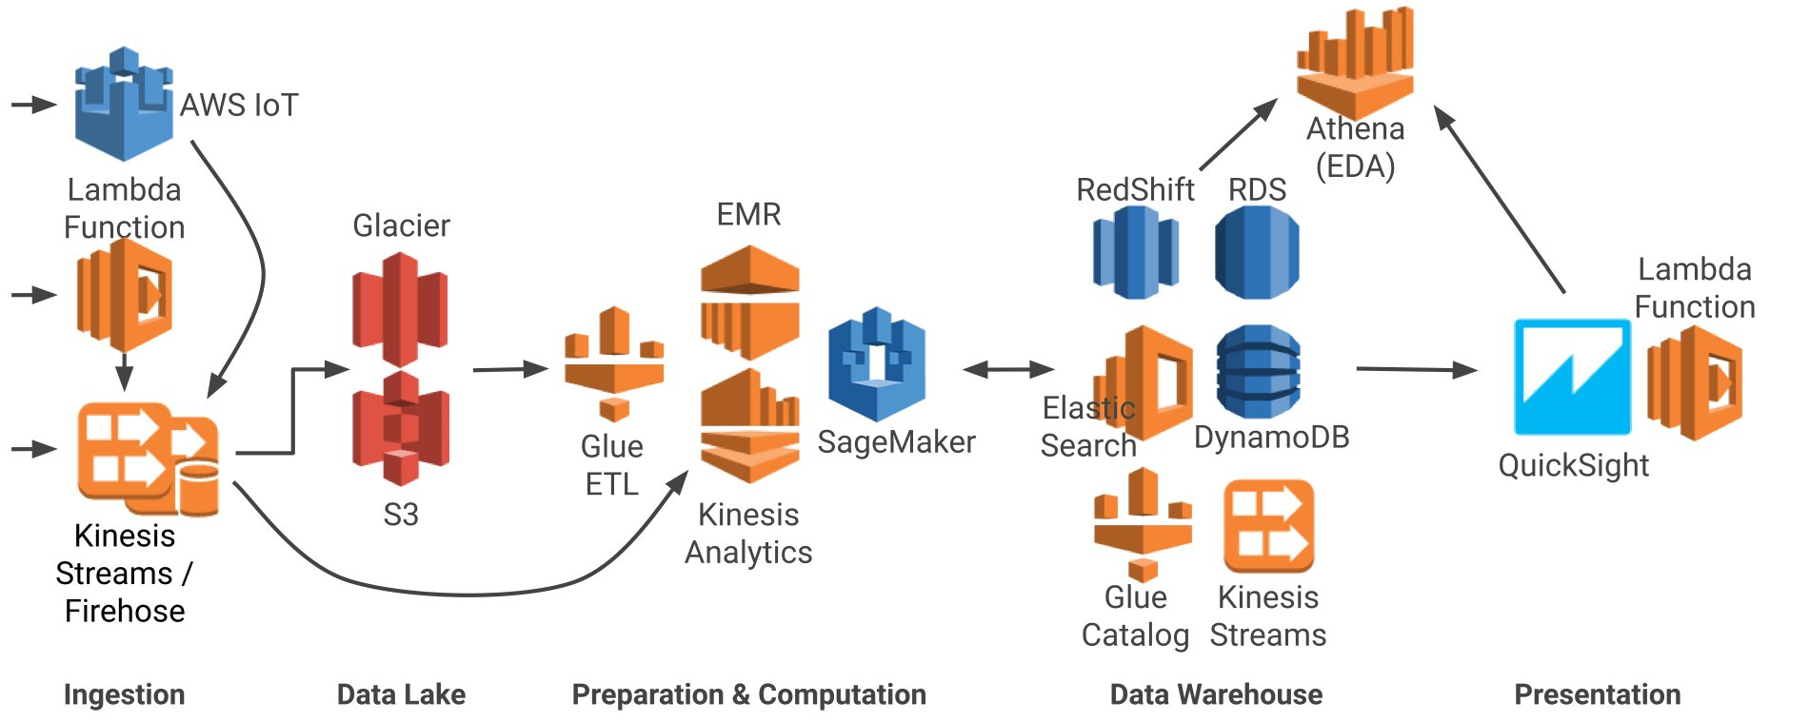
AWS Data Infrastructure

Slide 35
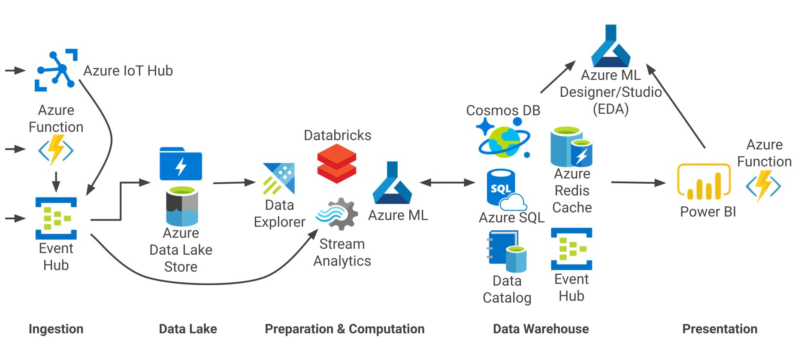
MS Azure Data Infrastructure

Slide 36
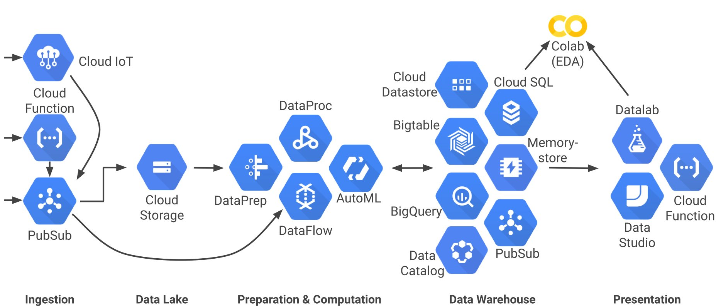
Google Cloud Data Infrastructure
Notes:
Apart from Amazon, Microsoft and Google, another main player in the cloud infrastructure game is Oracle.

Slide 37
Challenges and Future Directions
Remember data silos?
no, they did not just dissolve in the data lake unfortunately!
data marts specific to individual business units are key for value extraction
some data fragmentation has to be accepted
Companies are keen to “democratize data science”
by enabling business users to access all the data held by the organization
But raw data is typically redundant and messy
business users often lack the skills and/or the interest to dive in it
Are we ready for the rise of the “citizen data scientist”?
vendors are eager to sell “self-service analytics” apps
but whether or not they can fulfill their promise is unclear
Notes:
Self-service analytics tools are revolutionizing Business Intelligence, by enabling the end-user to access the data wherever it resides. But something’s got to give: some software can generate a simplified data model, which may result in imperfectly managed data; or the user can perform some amount of data wrangling, which may not be for everybody.
For companies, the tradeoff is between not having perfectly managed data and empowering a greater number of people to find meaningful correlations in it. This issue needs to be taken into careful consideration. A solution may ultimately come from a massive educational effort to equip business users with the required data analysis skills. Or, perhaps, a combination of education and self-service tools adoption (since data, and complexity, will keep on growing).
Here is a non-exhaustive list of self-service analytics tools: Sisense, Domo, Dundas BI, Qlik Sense, IBM Cognos analytics, Yellowfin etc.. (https://www.softwareadvice.com/bi/self-service-tools-comparison/)
Here is the definition of self-service analytics by Gartner:
https://www.gartner.com/en/information-technology/glossary/self-service-analytics

Slide 38
Module Review
What are the 5 V’s of Big Data?
What is a data mart?
What is a data swamp?
How do data lakes fit into a more traditional data architecture?
Who are the main providers of cloud-based systems?
What are the challenges / opportunities for self-service analytics?

Slide 39
Questions

